Slide 1
English Writing II
Week 16 Abstract, References, and Course summary

Slide 2
In today’s class
Abstract
Citation format (APA)
Course summary

Slide 3
Abstract
A 150- to 250-word paragraph that provides readers with a quick overview of your paper and its organization. It should express your thesis and the key points; it should also suggest any implications or applications of the research you discuss in the paper.
10-minute scanning of the abstracts

Slide 4
Major components
Motivation/ Purpose/ problem-statement
Research method
Findings/ results
Conclusion/implications
→ “a concise summary of the entire paper.”
Research paper (Oral Fluency).pdf

Slide 5
Types of Citation Formats
In-text citation and “References”
MLA – Modern Language Association
→ humanities: art, literature, music, philosophy, etc.
APA – American Psychological Association
→ social sciences: business, communication, education, psychology, etc.

Slide 6
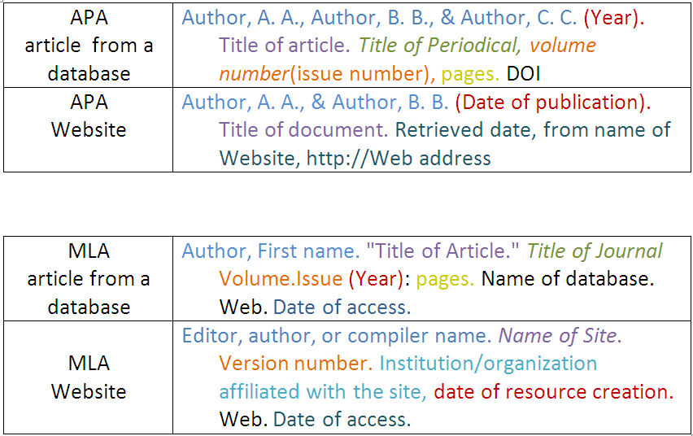

Slide 7
References (APA format)
Research paper (Pausing in Writing).pdf

Slide 8
Tables

Slide 9
Figures

Slide 10
Figures

Slide 11
Figures

Slide 12
Stylistic and academic conventions
Rules and principles of academic engagement of a discipline that are generally acceptable among scholars of that discipline.

Slide 13
Academic writing should be …
Clear and precise
Concise and plain
Logical and coherent
Objective and balanced
Academic and formal

Slide 14
Course summary: Long articles
Feature article – facts (6 weeks)
Opinion piece – opinion (6 weeks)
Research paper – research (4 weeks)

Slide 15
Writing skills
Facts and details
Data interpretation
Use of analogy
PEE paragraphs
Counterarguments and rebuttal
IMRD structure

Slide 16

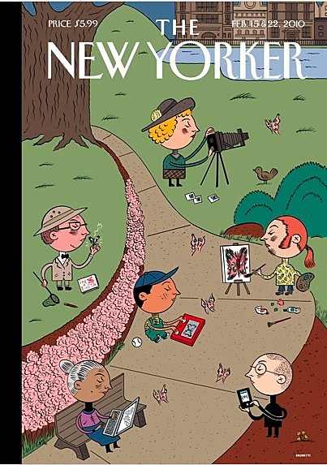

Reading for writing

Slide 17

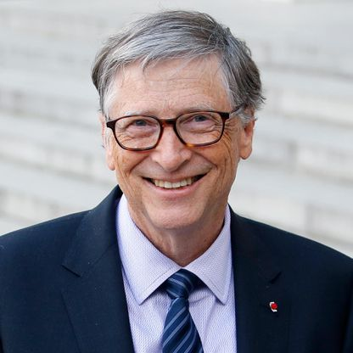

Reading for writing

Slide 18
Topics we’ve covered
Bird flu, malaria and other pandemics
Getting ready for the next pandemic
Pandemic and the future world
Pandemic and balcony
Pandemic and English new words
Racism in the pandemic

Slide 19
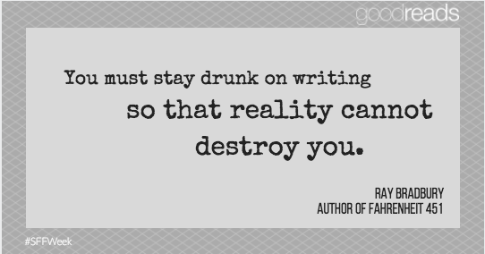
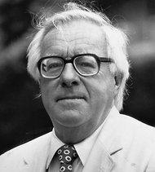

Slide 20
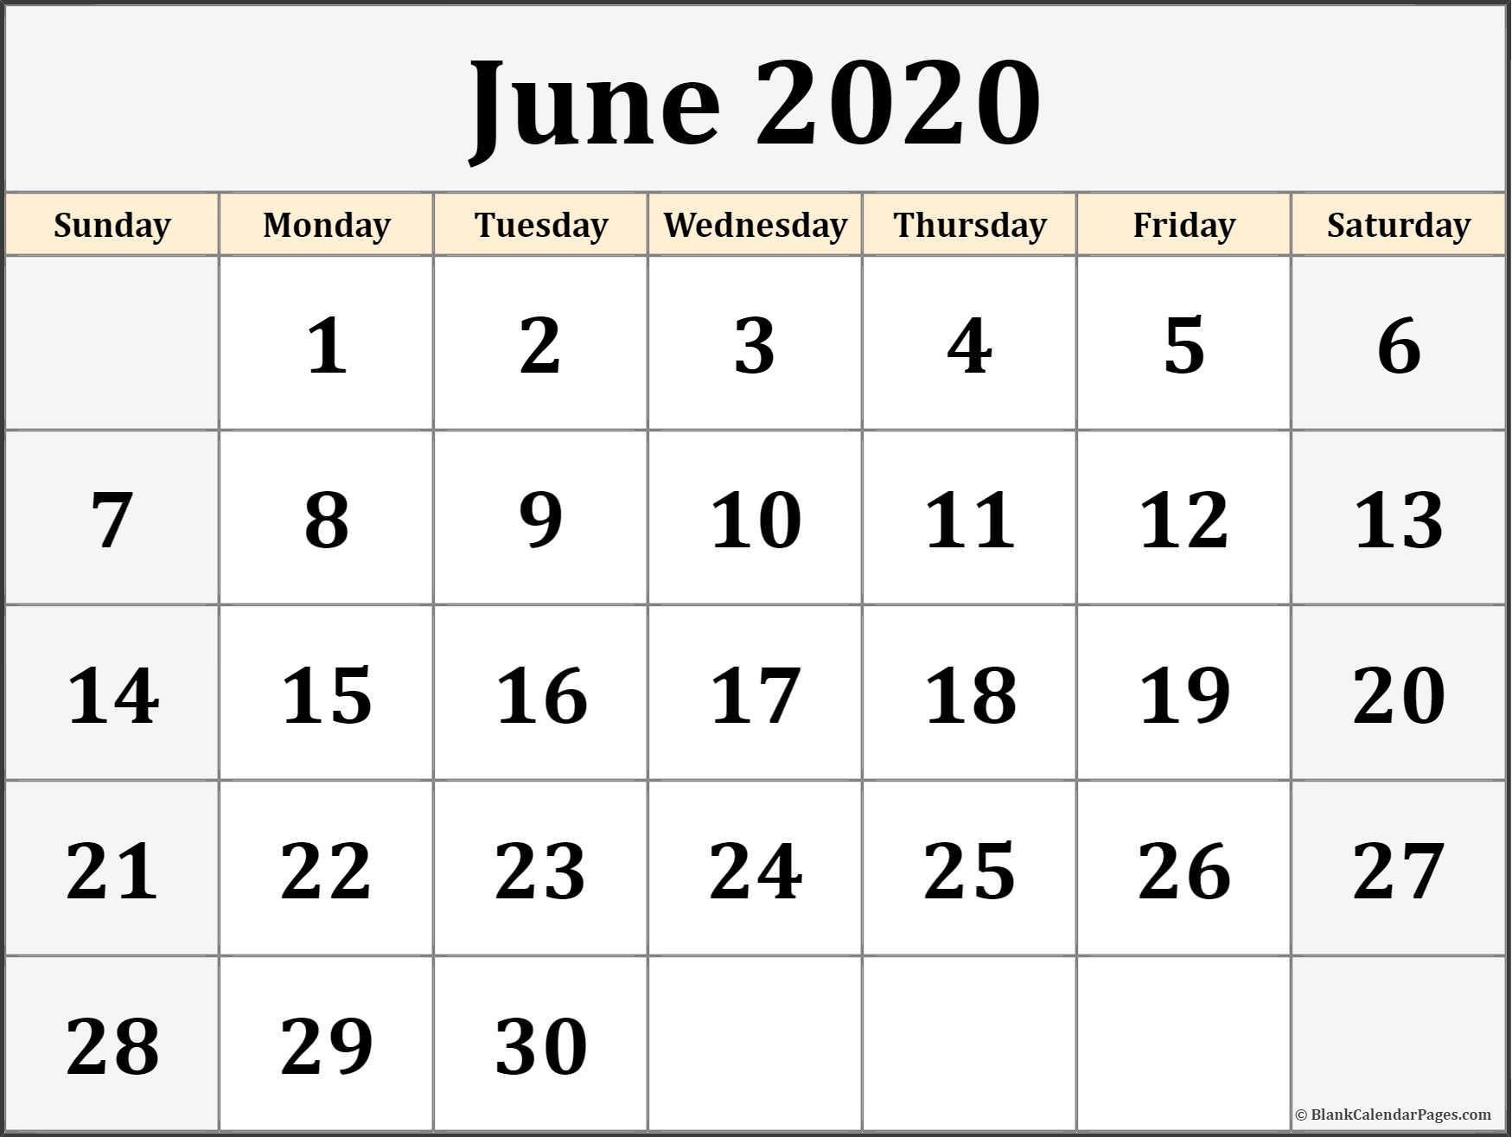
The Final Project
IMRD structure, 1200-1500 words
APA format (for References)
DDL: 11:30 am. June 22nd , 2020

